Slide 1
Project 4
Spotify Music
Popularity Prediction
Tree-based regression model • RMSE comparison
• Feature importance • Predicted song scores
Goal: predict a numeric Popularity score from song/audio features available before a song becomes popular.
Presentation guide with sample code and result screenshots

Slide 2
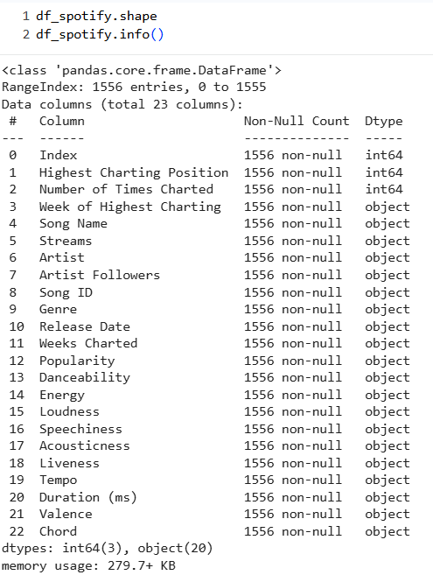
Spotify Project 4
Problem Definition
What are we predicting?
target = "Popularity"
X = df_model.drop(columns=["Popularity"])
y = df_model["Popularity"]
# Model learns:
# song features -> popularity score
Target variable: Popularity
Problem type: regression
Success metric: lower RMSE
Model output: predicted Spotify popularity score
Data : https://ddc-datascience.s3.amazonaws.com/Projects/Project.4-Spotify/Data/Spotify.csv
Using this model, I predicted how popular a song could be on Spotify based on available song characteristics.
2

Slide 3
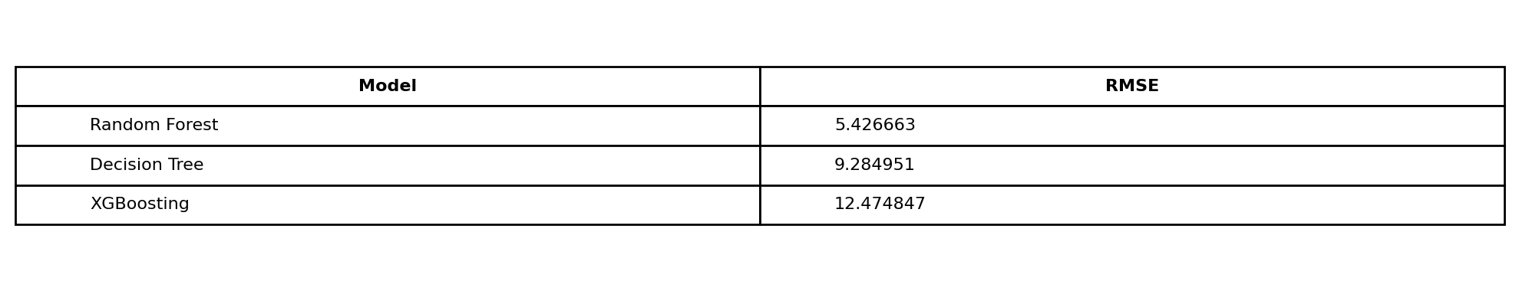
Spotify Project 4
Solution Approach
1
Load data
2
Clean data
3
Engineer features
4
Train models
5
Compare RMSE
models = {
"Decision Tree": DecisionTreeRegressor(max_depth=3),
"Random Forest": RandomForestRegressor(n_estimators=100, max_depth=10),
“XGBoost”:xgb.XGBRegressor(objective ='reg:squarederror', verbosity=0, seed = 10)
"Gradient Boosting": GradientBoostingRegressor(n_estimators=100, learning_rate=0.05, max_depth=3)
}
for name, model in models.items():
model.fit(X_train, y_train)
y_pred = model.predict(X_test)
rmse = np.sqrt(mean_squared_error(y_test, y_pred))
Sample model comparison output
The model with the lowest RMSE is selected as the best model for prediction and explanation.
3

Slide 4

Spotify Project 4
Data Cleaning
Main cleaning decisions
numeric_pattern = r"^-?\d+(\.\d+)?$"
for col in object_cols:
s = df_cleaned[col].astype(str).str.strip()
s_clean = s.str.replace(",", "", regex=False)
match_rate = s_clean[df_cleaned[col].notna()].str.match(numeric_pattern).mean()
if match_rate >= 0.8:
df_cleaned[col] = pd.to_numeric(s_clean, errors="coerce")
Removed comma formatting from numeric text values
Converted numeric-looking object columns to numbers
Dropped rows where numeric conversion failed
Kept only Genre and Chord as categorical predictors
Encoded Genre and Chord using label encoding
# Drop all categorical columns except Genre and Chord
categorical_to_keep = ["Genre", "Chord"]
# Convert kept categories into numeric labels
for col in categorical_to_keep:
encoder = LabelEncoder()
df_cleaned[col] = encoder.fit_transform(df_cleaned[col].astype(str))
4

Slide 5
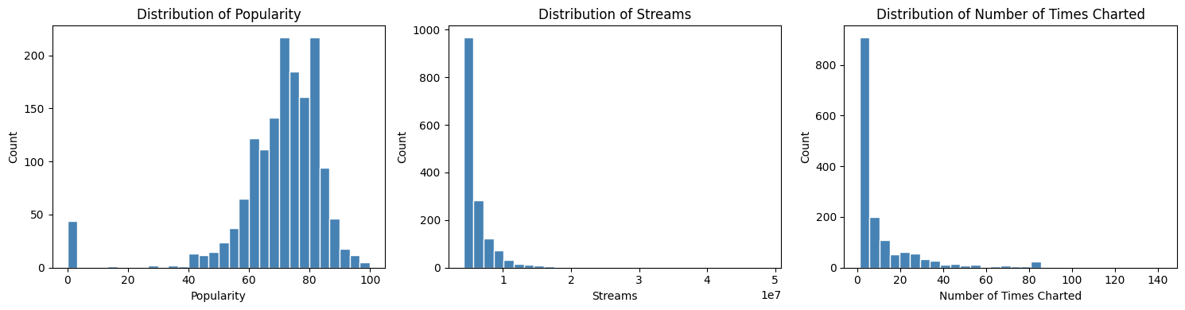
Spotify Project 4
EDA: Understanding Popularity and Chart Fields
Popularity is the final target because it is already numeric and directly aligned to the project goal.
Streams and charting columns are useful for exploration, but should not be predictors for a new song.
EDA helps identify skew, outliers, and possible leakage variables.
Key idea: EDA is not only for charts; it also helps decide which variables should be allowed into the model.
Distribution screenshots from EDA
df_spotify.describe().transpose()
df_spotify.isna().sum()
df_spotify.dtypes
# Explore candidate targets
["Popularity", "Streams", "Number of Times Charted"]
5

Slide 6
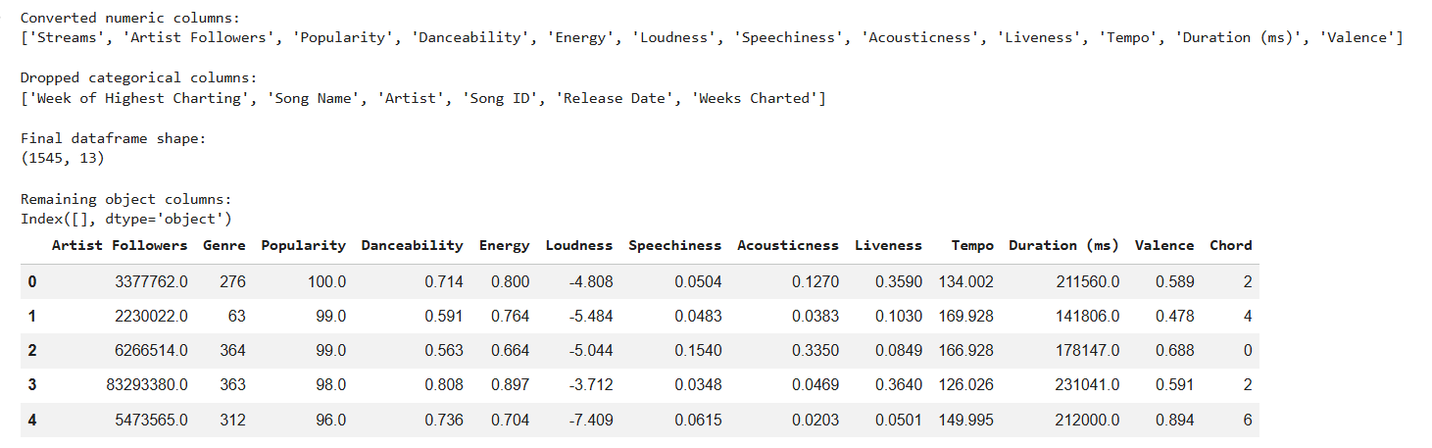
Spotify Project 4
Feature Selection: Avoid Data Leakage
Columns removed from predictors
leakage_cols = [
"Highest Charting Position",
"Number of Times Charted",
"Streams",
"Week of Highest Charting",
"Weeks Charted"
]
df_model = df_model.drop(columns=leakage_cols, errors="ignore")
Highest Charting Position
Number of Times Charted
Streams
Week of Highest Charting
Weeks Charted
Song Name / Song ID / Artist for model input
Why: these values are known after release/chart performance. Using them to predict a new song would make the model “cheat.”
Allowed predictors include audio features, Artist Followers, Genre, Chord, and simple release-date features.
6

Slide 7
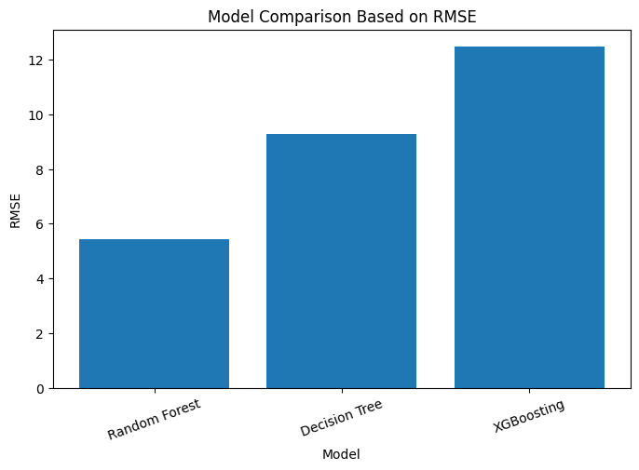
Spotify Project 4
Model Training and RMSE Comparison
RMSE table
RMSE measures how far predictions are from actual popularity values.
Lower RMSE means a better model.
Random Forest performed best in the sample results shown.
RMSE comparison graph
rmse = np.sqrt(mean_squared_error(y_test, y_pred))
results.append({
"Model": model_name,
"RMSE": rmse
})
7

Slide 8
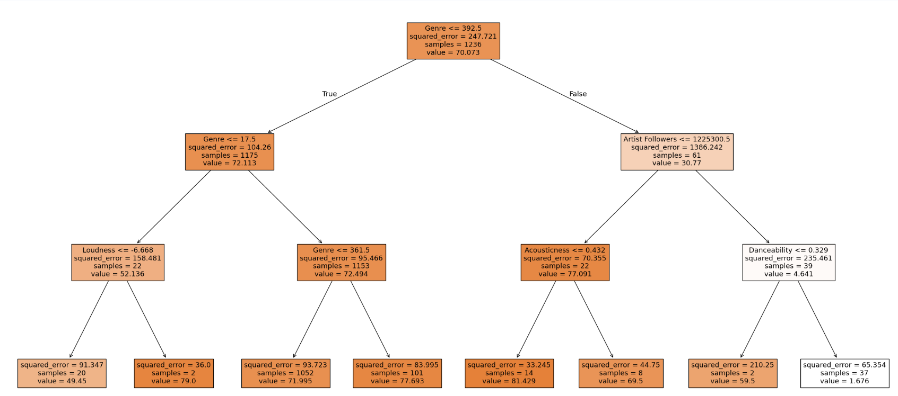
Decision Tree
Max_depth =3

Slide 9
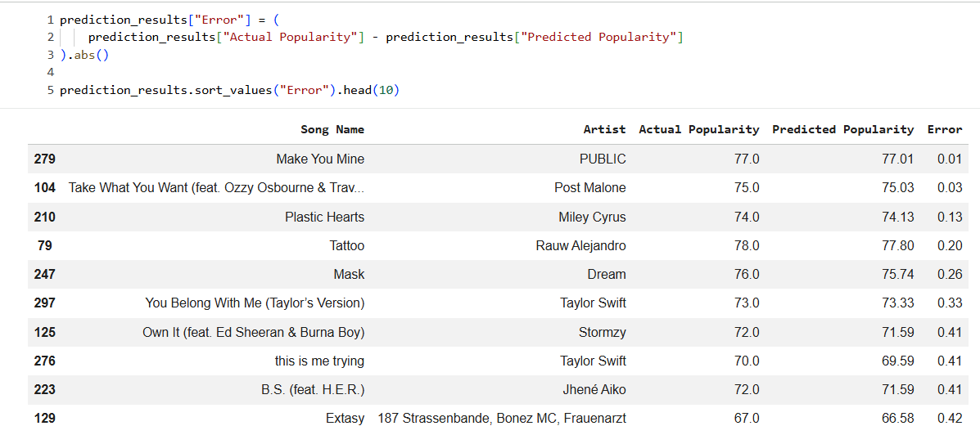
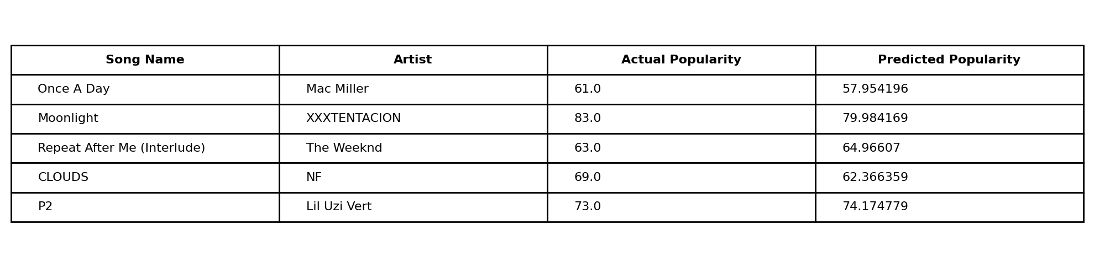
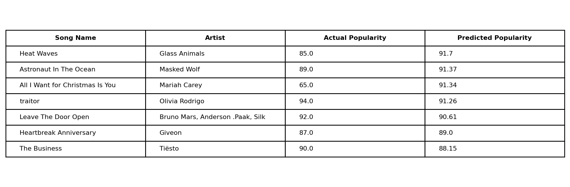
Spotify Project 4
Prediction Results: What Did the Model Predict?
The actual prediction happens here:
best_predictions = best_model.predict(X_test)
prediction_results = pd.DataFrame({
"Song Name": song_test.values,
"Artist": artist_test.values,
"Actual Popularity": y_test.values,
"Predicted Popularity": best_predictions
})
Sample prediction table
This table answers: “ what predicted score?”
Top predicted songs table
8

Slide 10
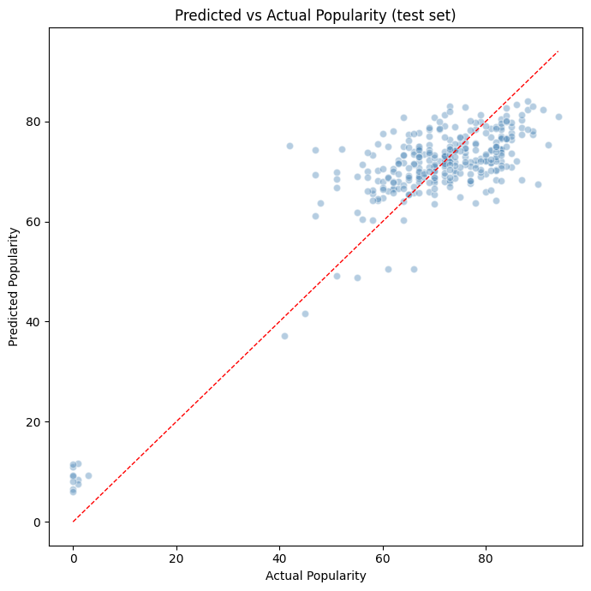
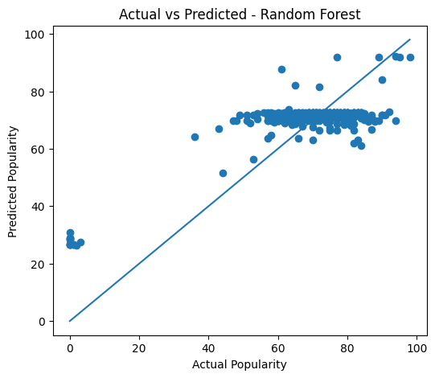
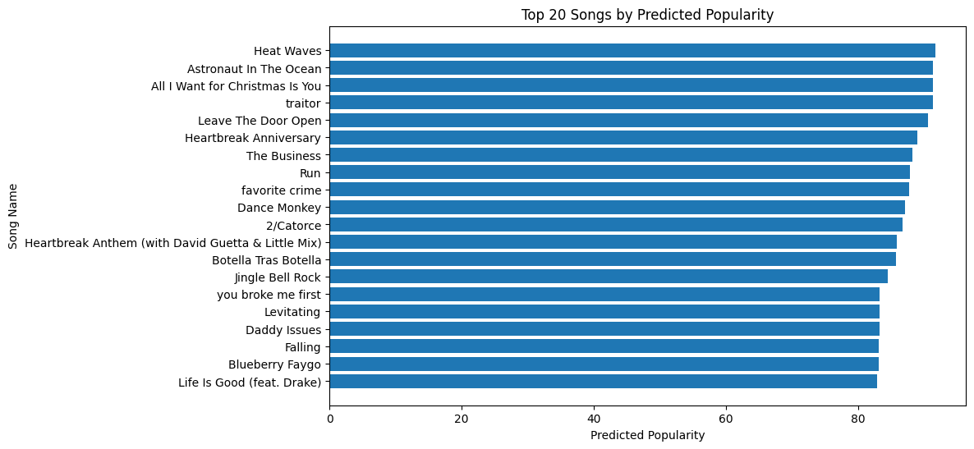
Spotify Project 4
Visualization: Actual vs Predicted and Top Songs
Random Forest actual vs predicted
Top predicted songs chart
plt.scatter(y_test, y_pred)
plt.plot([y_test.min(), y_test.max()],
[y_test.min(), y_test.max()])
plt.xlabel("Actual Popularity")
plt.ylabel("Predicted Popularity")
9

Slide 11
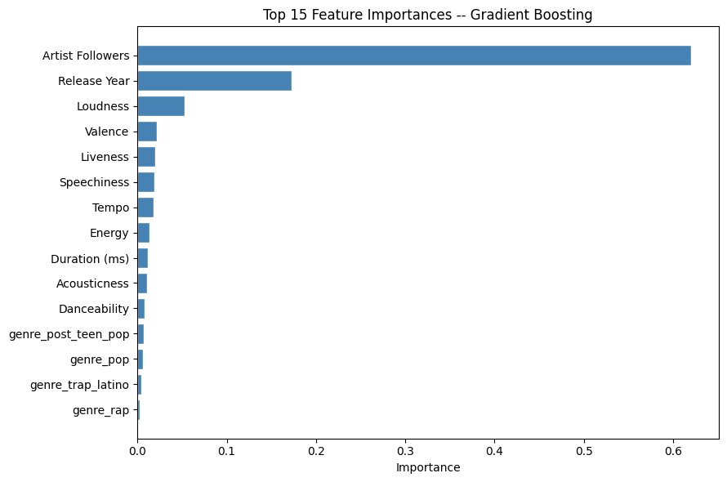
Spotify Project 4
Cross-Validation and Feature Importance
scores = cross_val_score(
model, X, y,
scoring="neg_root_mean_squared_error",
cv=5
)
mean_cv_rmse = (-scores).mean()
Cross-validation gives a more reliable estimate than one train/test split.
Feature importance explains which variables drive predictions.
Artist Followers and release timing were strong drivers in the shown result.
Top feature importance screenshot
I selected the model with the lowest cross-validated RMSE and reviewed feature importance to explain the result.
10

Slide 12
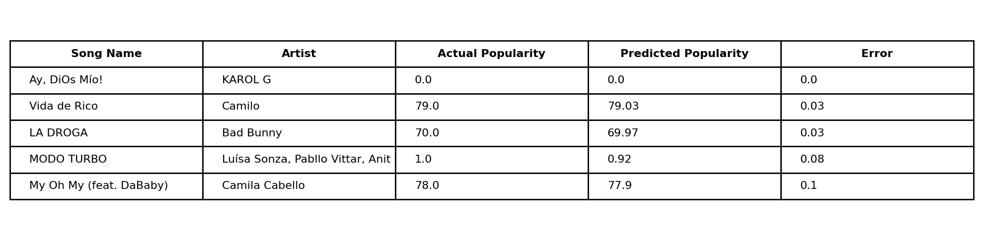
Spotify Project 4
Final Conclusion
This project predicted Spotify Popularity as a numeric regression target.
Data cleaning converted numeric text and handled categorical Genre and Chord.
Leakage columns were removed to make the prediction fair for new songs.
Three tree-based models were compared using RMSE and cross-validation.
Prediction tables and graphs show the model outputs song-level predicted scores.
Examples with smallest prediction error
# Final reporting table
prediction_results.sort_values(
by="Predicted Popularity",
ascending=False
).head(10)
The model estimates each song’s popularity score and helps explain which features influence that score.
11

Slide 13
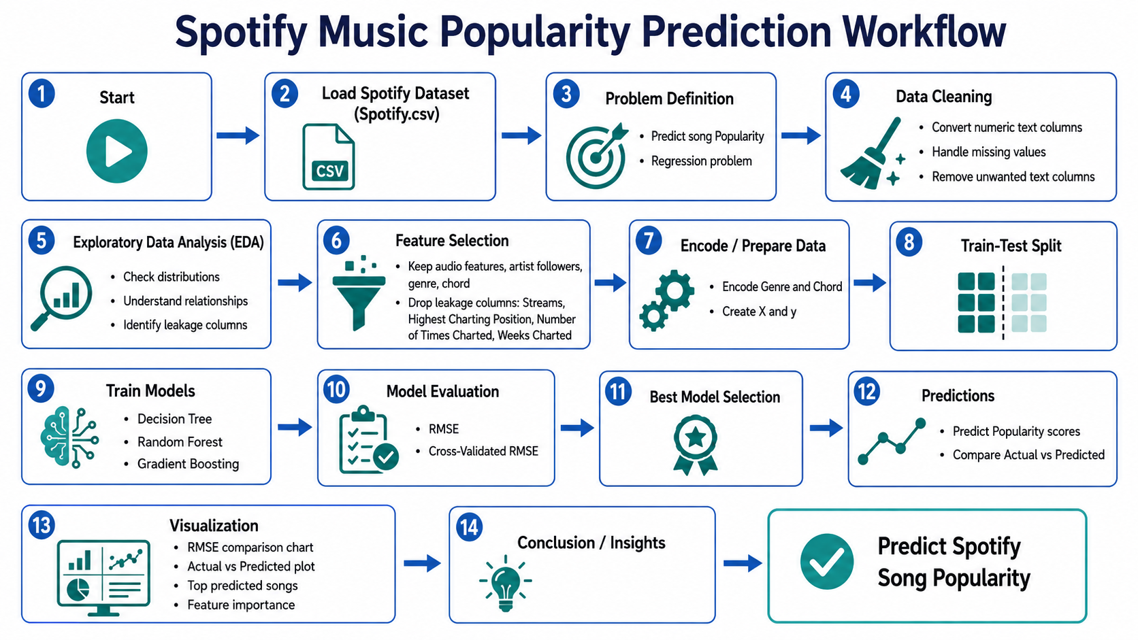
Spotify Project 4
2

Slide 14
Spotify Project 4
11

